Slide 1
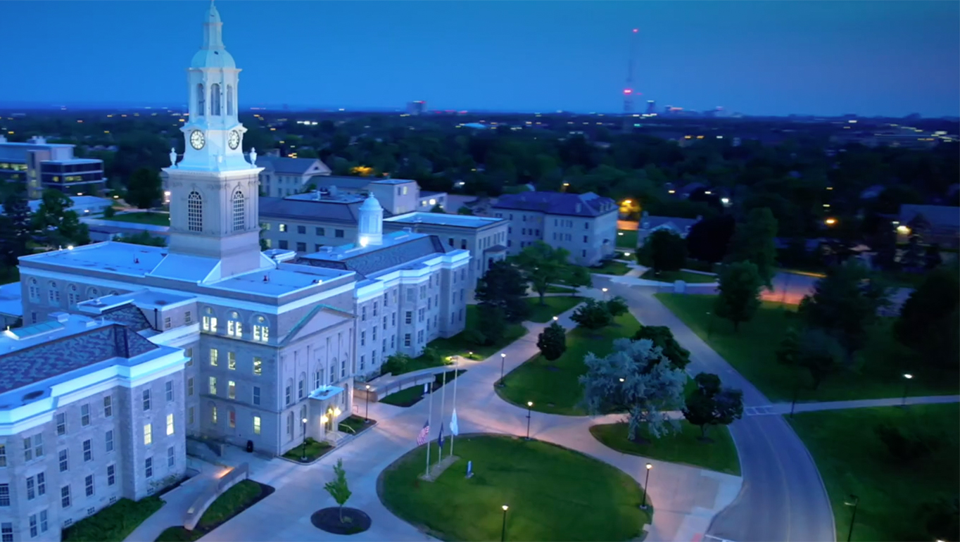
Developing an Open-Source College and University Prediction Model for United States Institutions
Dylan Zelko
EAS 345

Slide 2

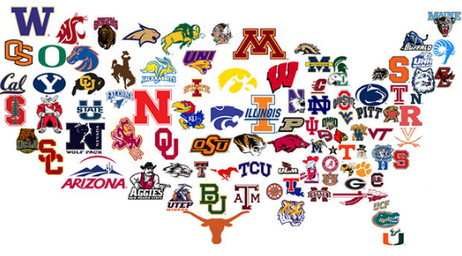
Introduction
1.3 million first-year students apply to universities and colleges across the United States
Many of these students utilize online resources like U.S. News to aid in their decision
These resources are valuable but are generally very broad and behind a paywall

